Slide 1
Requirements for BGP modeling
More?
David Freedman – Claranet
Ignas Bagdonas – Routing System

Slide 2
YANG
RFC 6020/6021 (NETMOD WG)
Modeling language to define / modularise NETCONF XML
Modern alternative to SMIv2 (which in turn, modularised ASN.1 in SNMP)
More than we can explain in a lightning talk.
See https://ripe68.ripe.net/presentations/181-NETCONF-YANG-tutorial-43.pdf

Slide 3
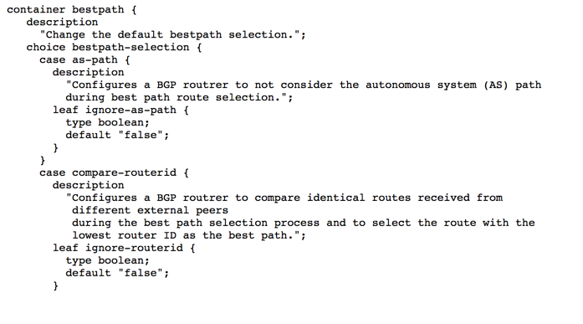
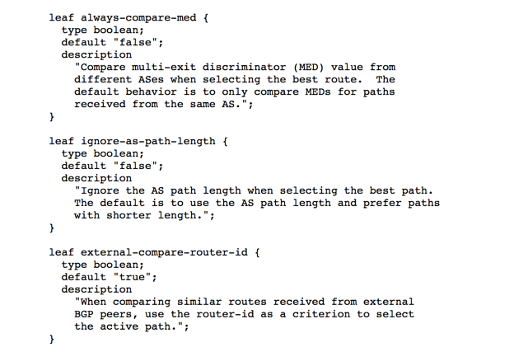
YANG meets BGP
http://www.ietf.org/id/draft-zhdankin-netmod-bgp-cfg-01.txt
vs http://www.ietf.org/id/draft-shaikh-idr-bgp-model-00.txt)
NETMOD = Cisco
IDR = Google, AT&T, MS, BT
Both quite low level.
IDR contains more operational facets.
IDR an agenda item Tuesday (13/11).
NETMOD not an agenda item (yet).
IDR seems to have progress!

Slide 4
So, what is our point?
No provision for expressing routing policy (we think)
How can we simplify asking for abstracted concepts?
Best exit from my network for this service should be <X>
Prefer these peering prefixes over exchange <Y>
etc..
If YANG to be considered a DSL, are we happy with the scope of the domain?
Do we need an upper layer which describes policy?
If you feel strongly about this, send us a mail:
Aim to pass on operator feeling at next weeks’ IETF.
yang@convergence.cx

