Slide 1
RIPE Programme Committee Update
Filiz Yilmaz, RIPE PC Chair
RIPE 69, London
Notes:
Hello.
Welcome to RIPE 69, thanks to the sponsors and especially to the local host for enabling this meeting in London.
My name is Filiz Yilmaz. I am chairing the RIPE Programme Committee who is responsible of the RIPE Meeting content partially.

Slide 2
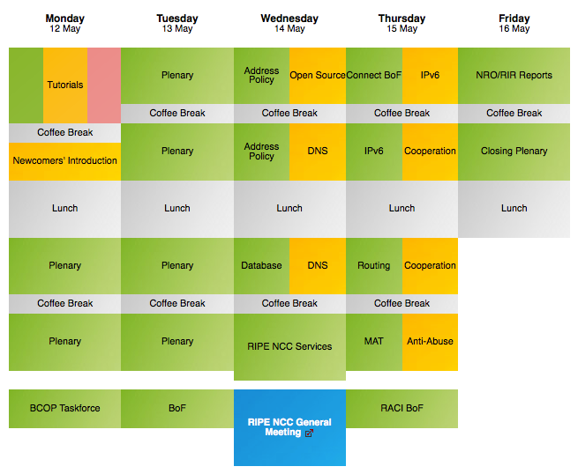
What do we do?
Notes:
Why partially?
We put together the Monday, Tuesday and a bit of the Friday content.
Speakers do not get any special treatment; they are neither paid nor their costs are covered. In this sense RIPE meetings are real sense of volunteer based meetings.
ALSO note this is not the WG content. WGs take place on Wednesday and thursdays. That partof the meeting’s organization is quite different than the Plenary part, wth their own scheduling and Chairs as well.

Slide 3
Plenary Content
What RIPE community likes
Towards general audience interest
Mixed bag of
operational, policy and philosophical content
long, medium, short talks
informal gatherings
Notes:
So what is Plenary agenda. The content is towards general audience interest and of course about what RIPE Community wants and likes to see/hear.
So it is a mix of operational, policy and at times philosophical content. We try to find the right balance between these actual and hot topics and cover, security, DNS, addresssing, routing and policy issues. But we do not get into too much details in these.
In fact, longest talks are 30 mins long during prime time plenary. Again this is different than WG content. WGs deep-dive into detail and continue working on subjects over meetings. We also have tutorials and workshops which receive longer time but they are placed on Monday mornings or at the evenings.
BoFs are informal gatherings and Ligtening Talks are real short and seek for quick instant shock/wow-factor.

Slide 4
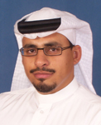
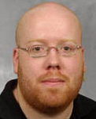
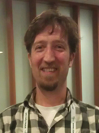
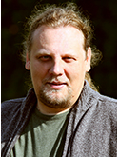
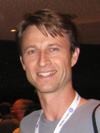
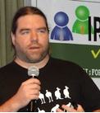
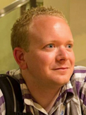
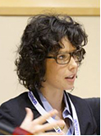
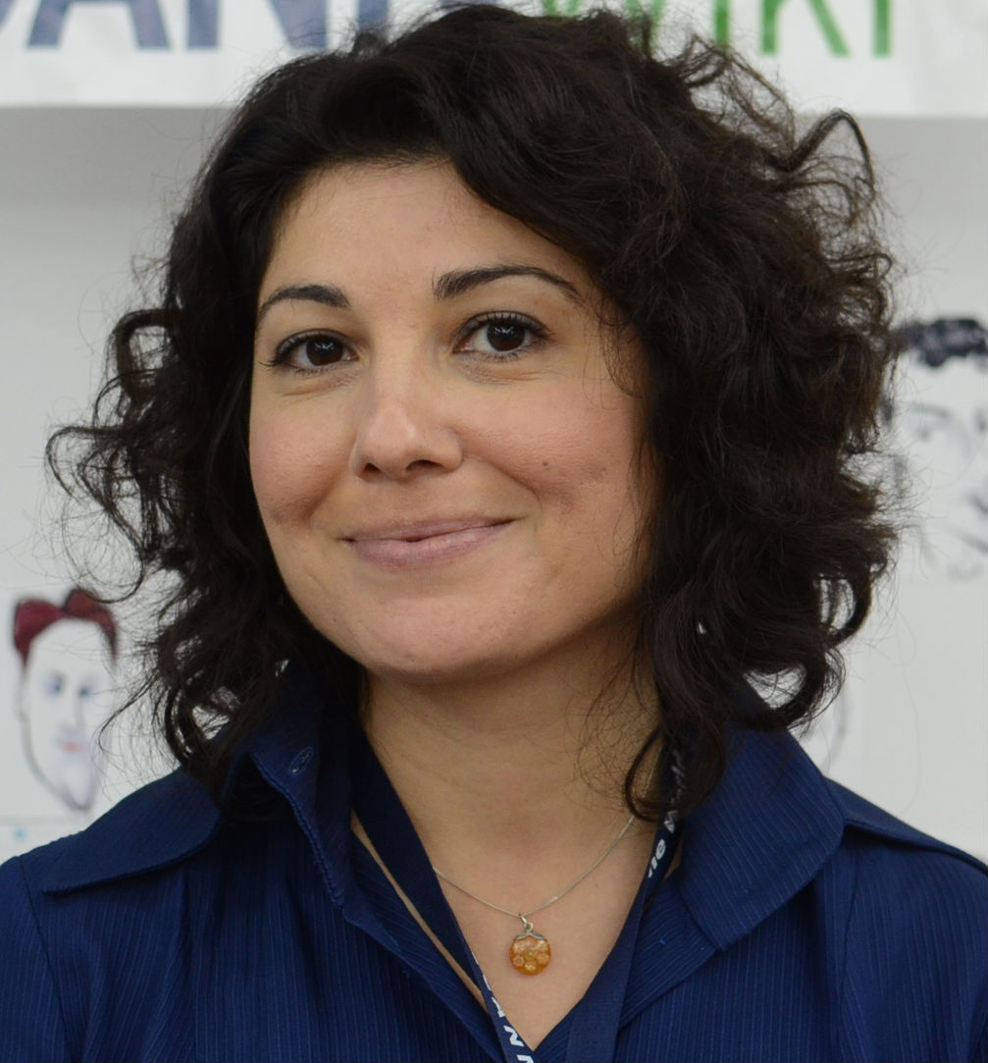
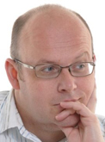
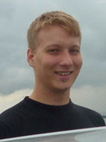
Who does that?
PC Elections on Friday for 2 seats!
Bio/statement of interest + a Picture
pc@ripe.net
Nominate until Thursday 15:00 pm
https://ripe69.ripe.net/programme/ripe-pc/become-a-member/
https://www.ripe.net/ripe/docs/ripe-600
Notes:
If you want to join this gang and serve the community, you can consider nominating for the PC. We will have elections for 2 seats this Friday.
Information on how to and the PC Charters are at these links. DON’T forget to nominate until 3 pm on Thursday.

Slide 5
But take a moment to reflect first...
Expectations | Benefits
Recruit talks | Satisfaction for serving to the community
Read/Rate/Comment 40- 70 submissions | Industry and peer visibility
Attend 4-5 conference calls (mostly in CET) | Repeat the steps above
Communicate with PC/RIPE NCC/Presenters/RIPE community
Notes:
I would like to point out that it is a seat where there are expectations and workload and time commitment can be demanding at times.
You are expected all these on the right hand side, ….
AND keep in touch with the PC mailing list at all times. We do lots of work online. In return you get……
AND you may need to repeat the steps above or remind yourself of them frequently :D.

Slide 6
RIPE 69 Numbers
Received: Lots-ish…
37 Plenary, 4 BoFs, 5 Tutorials, 4 Workshops, 13 Lightning talks (&still counting)
8 September: Draft agenda published
8 October: Final agenda published
More Lightning talks this time
Notes:
Now, shortly looking at this meetings agenda building….
We received slightly more submissions than average this time, THANK YOU!
And majority where on time too :D! SO DOUBLE THANK YOU!
You may have noticed we often make two calls: A deadline allowing to publish a draft agenda about 8 weeks before the meeting and a final one that is published 4 weeks priorto the meeting if there is still space in the agenda. We can normally accommodate 16 plenary talks What happens here is this: IF YOUR TALK is really good and you submit it in time, then you get the SLOT, IF your TALK is good but you are very last minute, then you risk the SPACE. So pls be on time, this system allows ripe audience to see some part of the agenda and convince powers to attend the meeting if that is necessary. More people can attend, the better the overall meeting can be. This also allows PC shepherd some talks to make them good or better for plenary. It allows better and more sane evaluation time. So it is a win-win.

Slide 7
Help and feedback appreciated!
Rate talks
Win a prize!!
Write to pc@ripe.net
Talk to PC members

