Slide 1
ECDSA P-256 support in DNSSEC-validating Resolvers
Geoff Huston, George Michaelson
APNIC Labs
October 2014

Slide 2
ECDSA
Elliptic Curve Cryptography allows for the construction of “strong” public/private key pairs with key lengths that are far shorter than equivalent strength keys using RSA
  “256-bit ECC public key should provide comparable security to a 3072-bit RSA public key” *
And the DNS protocol has some sensitivities over size
  UDP fragmentation has it’s issues in V4 and V6
* http://en.wikipedia.org/wiki/Elliptic_curve_cryptography

Slide 3
So lets use ECDSA for DNSSEC
  Yes?
  Or maybe that’s a Bad Idea!
  Is ECDSA a “well supported” crypto protocol?
  If you signed using ECDSA would they validate it?

Slide 4
The Test Environment
We used the Google Ad network to deliver a set of DNS tests to clients to determine whether (or not) they use DNSSEC validating resolvers
We used 4 tests:
  no DNSSEC-signature at all
  DNSSEC signature using RSA-based algorithm
  DNSSEC signature using broken RSA-based algorithm
  DNSSEC signature using ECDSA P-256 algorithm

Slide 5
The Test Environment
Unsigned
d.t10000.u2045476887.s1412035201.i5053.vne0001.4f167.z.dashnxdomain.net
e.t10000.u2045476887.s1412035201.i5053.vne0001.4f167.z.dotnxdomain.net
f.t10000.u2045476887.s1412035201.i5053.vne0001.4f168.z.dotnxdomain.net
g.t10000.u2045476887.s1412035201.i5053.vne0001.4f167.y.dotnxdomain.net
RSA Signed
RSA signed (Badly)
ECDSA-Signed
Mapped to a wildcard in the zone file
Unique Signed
Zone

Slide 6
A Naïve View
A non-DNSSEC-validating resolver query:
A DNSSEC-Validating resolver query:
A?
Single A Query
DNS Forwarders
A
A + EDNS0(DNSSEC OK)?
DS + EDNS0(DNSSEC OK)?
DNSKEY + EDNS0(DNSSEC OK)?
DNS Forwarders
A + RRSIG
DS + RRSIG
DNSKEY + RRSIG
A, DS, DNSKEY Queries

Slide 7
Theory: DNSSEC Validation Queries
e.t10000.u2045476887.s1412035201.i5053.vne0001.4f167.z.dotnxdomain.net
Query for the A resource record with EDNS0, DNSSEC-OK
query: e.t10000.u204546887.s1412035201.i5053.vne0001.4f167.z.dotnxdomain.net IN A +ED
Query the parent domain for the DS resource record
query: 2f7b3.z.dotnxdomain.net): query: 4f167.z.dotnxdomain.net IN DS +ED
Query for the DNSKEY resource record
query: 2f7b3.z.dotnxdomain.net): query: 4f167.z.dotnxdomain.net IN DNSKEY +ED

Slide 8
Practice: The DNS is “messy”
Clients use multiple name servers, and use local timeouts to repeat the query
Resolvers may use server farms, so that queries from a common logical resolution process may be presented to the authoritative name server from multiple resolvers, and each resolver may present only a partial set of validation queries
Resolvers may use forwarding resolvers, and may explicitly request checking disabled to disable the forwarding resolver from performing validation itself
Clients and resolvers have their own independent retry and abandon timers

Slide 9
First Approach to answering the ECDSA question – Statistical Inference
A DNSSEC-aware resolver encountering a RR with an attached RRSIG that uses a known algorithm will query for DS and DNSKEY RRs
A DNSSEC-aware resolver encountering a RR with an attached RRSIG that uses an unknown/unsupported crypto algorithm appears not to query for the DNSKEY RRs

Slide 10
Results
Over 22 days in September 2014 we saw:
  3,773,420 experiments
  937,166 experiments queried for the DNSKEY RR of a validly signed (RSA) domain (24.8%)
  629,726 experiments queried for the DNSKEY RR of a validly signed (ECC) domain (16.6%)
If we assume that the DNSKEY query indicates that the resolver “recognises” the protocol, then it appears that there is a fall by 8.2% in validation when using the ECC protocol
1 in 3 RSA experiments that fetched the DNSKEY did not fetch the ECC DNSKEY

Slide 11
Results
Over 22 days in September 2014 we saw:
  3,773,420 experiments
  937,166 experiments queried for the DNSKEY RR of a validly signed (RSA) domain (24.8%)
  629,726 experiments queried for the DNSKEY RR of a validly signed (ECC) domain (16.6%)
If we assume that the DNSKEY query indicates that the resolver “recognises” the protocol, then it appears that there is a fall by 8.2% in validation when using the ECDSA protocol
1 in 3 experiments that fetched the DNSKEY in RSA did not fetch the ECDSA-signed DNSKEY

Slide 12
Hmmm
How does this relate to affected users?
How do validating resolvers manage an unrecognised algorithm failure?
Lets try again and look at both DNS query and web log data

Slide 13
DNS resolver failure modes for an unknown signing algorithm
If a DNSSEC-Validating resolver receives a response RRSIG with an unknown crypto algorithm does it:
  Immediately stop resolution and return a status code of SERVFAIL?
  Fetch the DS RR and then return a status code of SERVFAIL?
  Fetch the DS and DNSKEY RRs and then return a status code of SERVFAIL?
  Or does it abandon validation and just return the unvalidated query result?

Slide 14
Second Approach to answering the ECC question – DNS + WEB
Data collection: 10/9/14 – 4/10/14
552,104 clients who appear to be exclusively using RSA DNSSEC-Validating resolvers
ECC Results:
Success: 76.45% 361,698 Saw fetch of the DNSSEC RRs and the URL
Fetched the URL but appeared not to validate
Failure (1) 19.64% 108,411 Did not see query of DNSKEY, but fetched the URL
Failure (2) 1.47% 8,121 Saw only A queries, but fetched the URL
Failure (3) 0.84% 4,615 Saw queries with DO set and not set, fetched the URL
Did not fetch the URL
Failure (4) 1.07% 5,927 Saw query of the DNSSEC RRs, NOT URL
Failure (5) 0.34% 1,875 Saw query of A, DS, not DNSKEY, NOT URL
Failure (6) 0.12% 655 Saw only A queries, NOT URL
Failure (7) 0.08% 436 Saw queries with DO set and not set, NOT URL
Apparent Fail: 23.55% 130,040

Slide 15
Results
These results show that 76% of clients who appeared to exclusively use RSA DNSSEC-Validating resolvers were also seen to perform validation using ECDSA
22% of the the remaining clients fetched the object, even though the DNS queries showed that there was not a complete DNSSEC validation pass being performed
Just 1.6% of clients did NOT fetch the URL

Slide 16
What?
23.6% ECDSA validation failure is very surprising
  Don’t forget that the subsection of users’ resolvers being polled here already did RSA validation and appeared to correctly return SERVFAIL when the DNSSEC crypto was broken
The fact that most of the failures result in a fetch of the URL is even more surprising
  The expectation was that we would see far more SERVFAIL and far higher URL fail-to-fetch rates
  It seems that the resolvers involved in this behaviour appear to be tagging the domain as “not validatable” and passing back an “insecure” outcome

Slide 17
Where?
ECDSA failure rates – the % of users in each country who use RSA DNSSEC validating resolvers,
but fail to validate when the DNSSEC crypto algorithm is ECC. Top 24 countries, ranked by
Observed ECC Validation failure rates
1 MN 96.82 Mongolia
2 MT 96.68 Malta
3 FI 95.75 Finland
4 AD 93.41 Andorra
5 CY 92.61 Cyprus
6 BB 90.59 Barbados
7 FJ 89.93 Fiji
8 ZA 85.94 South Africa
9 AG 84.51 Antigua and Barbuda
10 LU 83.28 Luxembourg
11 AU 79.93 Australia
12 SI 79.51 Slovenia
13 NO 78.91 Norway
14 LY 77.13 Libya
15 YE 75.81 Yemen
16 GR 69.64 Greece
17 KW 68.69 Kuwait
18 RW 66.67 Rwanda
19 BY 63.38 Belarus
20 UA 62.15 Ukraine
21 KE 60.57 Kenya
22 BA 56.35 Bosnia and Herzegovina
23 JP 56.06 Japan
24 KZ 49.50 Kazakhstan

Slide 18
Who?
ECDSA failure rates – the % of users in each AS who use RSA DNSSEC validating resolvers, but fail to validate when the DNSSEC crypto algorithm is ECDSA – top 25 Ases ranked by ECC failure rate
AS Fail Rate Samples AS Description
1 7155 100.00 202 WB-DEN2 - Viasat Communications Inc.,US
2 44143 100.00 662 VIPMOBILE-AS Vip mobile d.o.o.,RS
3 22363 100.00 157 PHMGMT-AS1 - Powerhouse Management, Inc.,US
4 12638 99.53 215 AS12638 E-Plus Mobilfunk GmbH & Co. KG,DE
5 33929 99.39 164 MASICOM-AS Telemach d.o.o.,SI
6 37457 99.36 933 Telkom-Internet,ZA
7 16014 99.25 398 EE-EMT AS EMT,EE
8 10219 99.17 362 SKYCC-AS-MAIN SKY C&C LLC,MN
9 7679 99.11 450 QTNET Kyushu Telecommunication Network Co.,Inc.,JP
10 1759 98.98 2,644 TSF-IP-CORE TeliaSonera Finland IP Network,FI
11 11815 98.97 291 Cooperativa Telefonica de V.G.G. Ltda.,AR
12 16232 98.79 1,238 ASN-TIM TIM (Telecom Italia Mobile) Autonomous System,IT
13 5603 98.77 5,039 SIOL-NET Telekom Slovenije d.d.,SI
14 17711 98.71 155 NDHU-TW National Dong Hwa University,TW
15 4804 98.70 1,456 MPX-AS Microplex PTY LTD,AU
16 12644 98.60 930 TELEMACH Telemach Autonomous System,SI
17 15735 98.58 1,059 DATASTREAM-NET GO p.l.c.,MT
18 53142 98.57 210 Friburgo Online LTDA ME,BR
19 41164 98.13 267 GET-NO GET Norway,NO
20 7992 97.94 679 COGECOWAVE - Cogeco Cable,CA
21 44489 97.31 335 STARNET Starnet s.r.o.,CZ
22 39651 96.82 943 COMHEM-SWEDEN Com Hem Sweden,SE
23 27813 96.70 485 Teledifusora S.A.,AR
24 47956 96.50 371 XFONE XFONE COMMUNICATION LTD,IL
25 52263 96.14 233 Telecable Economico S.A.,CR

Slide 19
Why?
IPR issues:
OpenSSL only added ECDSA support as from 0.9.8 (2005)
Other bundles and specific builds added ECC support later
Others still do not include ECC today

Slide 20
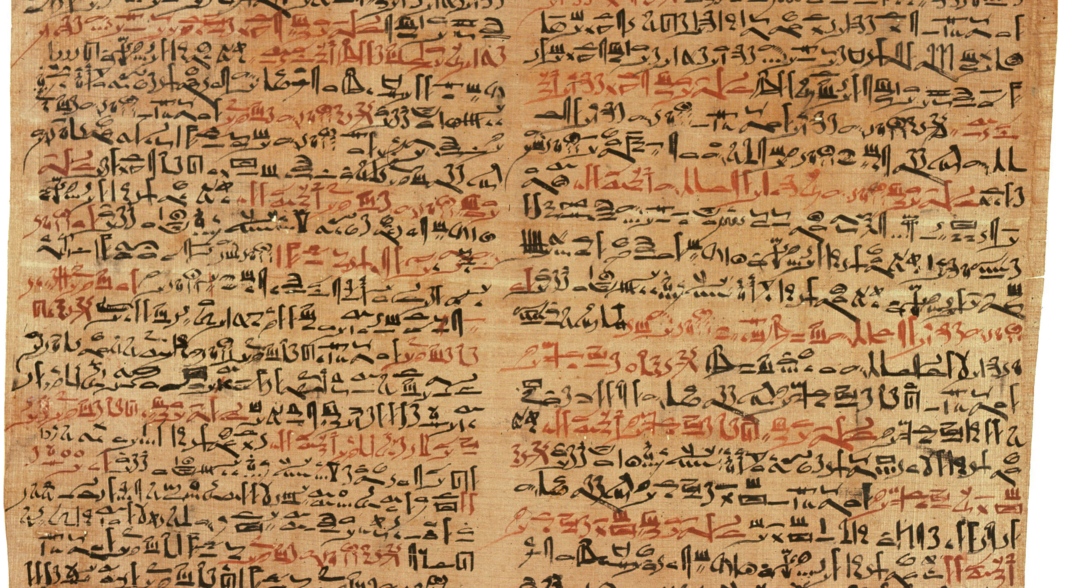
The Words of the Ancients

Slide 21
The Words of the Ancients
RFC 4035
If the resolver does not support any of the algorithms listed in an authenticated DS RRset, then the resolver will not be able to verify the authentication path to the child zone. In this case, the resolver SHOULD treat the child zone as if it were unsigned.

Slide 22
What About Google’s Public DNS?
$ dig geoff.00001.bad.x.dotnxdomain.net @8.8.8.8
; <<>> DiG 9.9.5-P1 <<>> geoff.00001.bad.x.dotnxdomain.net @8.8.8.8
;; global options: +cmd
;; Got answer:
;; ->>HEADER<<- opcode: QUERY, status: NOERROR, id: 1767
;; flags: qr rd ra; QUERY: 1, ANSWER: 1, AUTHORITY: 0, ADDITIONAL: 1
;; OPT PSEUDOSECTION:
; EDNS: version: 0, flags:; udp: 512
;; QUESTION SECTION:
;geoff.00001.bad.x.dotnxdomain.net. IN A
;; ANSWER SECTION:
geoff.00001.bad.x.dotnxdomain.net. 3587 IN A 203.133.248.10
;; Query time: 12 msec
;; SERVER: 8.8.8.8#53(8.8.8.8)
;; WHEN: Mon Oct 20 19:25:52 UTC 2014
;; MSG SIZE rcvd: 78
The ‘ad’ flag is missing from the response!

Slide 23
If 8.8.8.8 does not validate ECDSA
Data collection: 10/9/14 – 4/10/14
552,104 clients who appear to be exclusively using RSA DNSSEC-Validating resolvers
ECC Results:
Success: 24.59% 130,220 Saw fetch of the DNSSEC RRs and the URL
Apparent Fail: 76.41% 421,884

Slide 24
Is ECDSA a viable crypto algorithm for DNSSEC?
If the aim is to detect efforts to compromise the DNS for the signed zone, then signing a zone with ECDSA limits the number of DNS resolvers who will validate the signature
Which is a shame, because the shorter key lengths could be attractive for DNS over UDP

