Slide 1
Everybody Leaks
Alexander Azimov

Slide 2
Route Leaks
Abnormal subpath:
Provider -> Customer -> Provider
Provider -> Customer -> Peering
Peering -> Customer -> Provider
Peering -> Peering -> Peering
Amount?
Notes:
We define route leak as announces that have abnormal subpath: provide-customer-provider, etc.
What are the main features of route leaks? They increase latency, make your infrastructure vulnerable and undetectable from origin AS.
But what about amount of such incidents?

Slide 3
New Abnormal Paths Monthly
Notes:
This a graph describes amount of different abnormal paths we have detected during last few months.
AS you can see, we detect about two thousand of route leaks each month and we are still isn’t satisfied about opportunities of our detector.
But as far as I conern most part of the community still believe that problem is far away and don’t affect them at all.

Slide 4
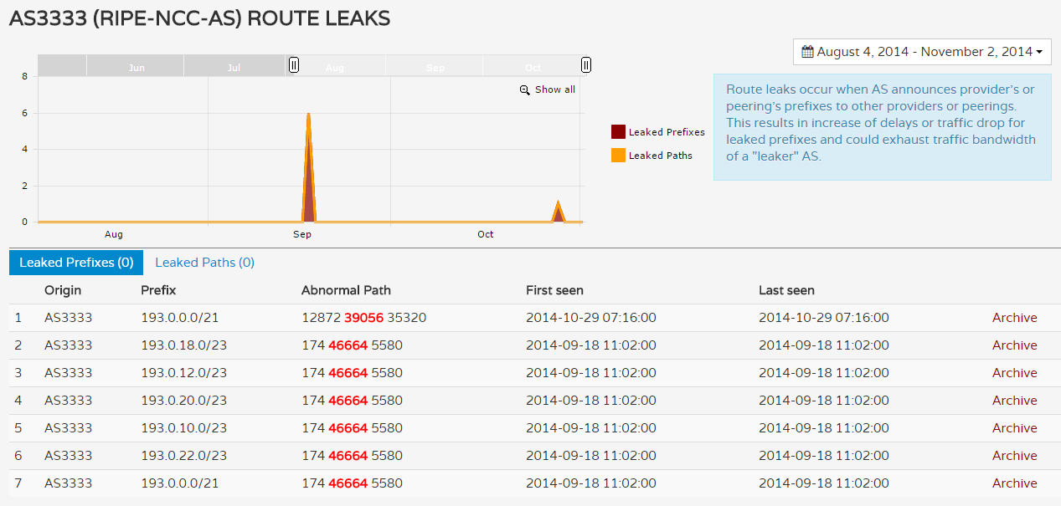
There problem is far away…
Notes:
Let us see. This is route leaks for RIPE NCC AS. This shot-term death leaks – when customer announces full table from one provider to another.

Slide 5
Leak Distribution
Notes:
But death leaks are rare, and they cover only 1% of all cases. The most common error is made not by customer AS, but by transit AS. It is made by using global prefix list for its customers, without paying attention to the origin of the announce. As a result, if customer stops announcing some part if its prefixes to this provider it will take alternative route. For a example from announce customer’s prefix from one provider to peers or also to other providers. If you are customer of such AS, you wouldn’t be able to redirect traffic from this AS in all cases, even if this provider experiencing stable packet loss. It just highlight that there is major misunderstanding how transit AS should work.

Slide 6
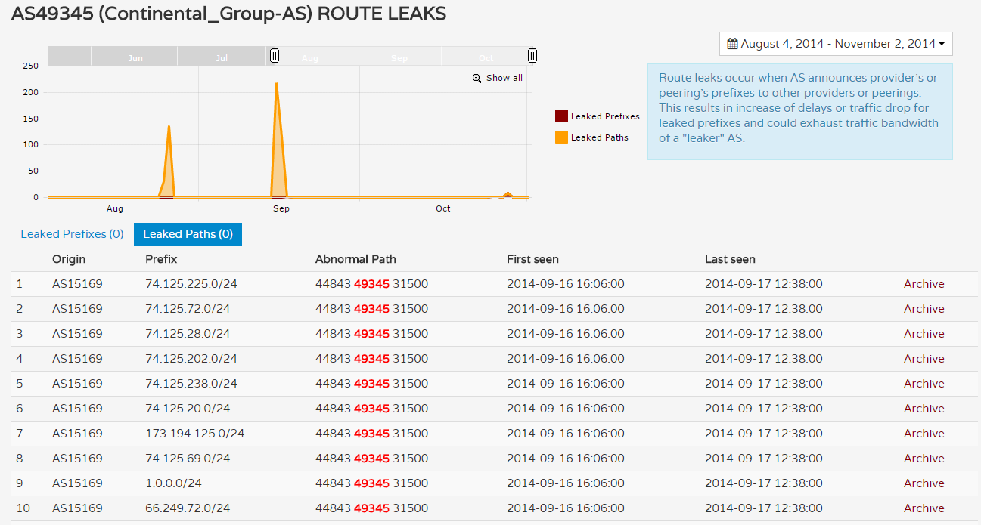
Strange leaks are very strange
Target Leak of Google’s prefixes
Notes:
And now strange leaks. By strange leak we define all leaks that we couldn’t simply explain. They don’t look like some common mistake - leaker and victim are not related to each other. In this issue were leaked all and only Google prefixes. I don’t think MIT could affect Google, but I could guarantee that this incident strongly affected latency to all Google services in Russian region.

Slide 7
Route Leak Dynamics
30% of leaks are long-term and unnoticed!
Notes:
The incident with Google lasted for a day. Despite the fact that most of routing incidents are short-term there are 30% of leaks that are stable. What does this mean? This just demonstrate that I are fully unnoticed.

Slide 8
What could be done?
Outbound prefix filtering;
Inbound prefix filtering or prefix limit;
Collaboration, more collaboration!
Announce isn’t end of story, you need to monitor it;
Notes:
So what could be done? First of all there are some common receipts such as prefix filtering or prefix limit. But at the same time community must understand that routing incidents are not related only to some well known hijacks that took place few years ago. It is about your prefixes and it is happening now.

Slide 9
Monitoring announces
Raw data
RIPE & Routeviews – thank you!
Renesys
BGPMon
Radar by Qrator
Notes:
If you want to monitor your prefixes you can use raw data from RIPE & Routeviews and I’d like to thank them for this opportunity.
There are also several projects, not all of them are free, that could provide you notifications related to routing incidents.

Slide 10
Questions?
radar.qrator.net

