Slide 1
eduroam: The Value of WLAN measurements for the R&E Community
RIPE69 – MAT-WG – Wednesday, 5 November 2014
Brook Schofield, GÉANT Association
schofield@terena.org
Notes:
Eduroam (education roaming) is a secure wireless server, developed for the international research and education community to support the mobility needs of staff, students and researchers.
The initiative allows people from participating institutions to obtain Internet connectivity through wireless (wifi), on their home campus, around town and abroad. In fact thousands of locations in over 58 countries offer this service.
Find out how eduroam can benefit your organisation, what initiatives are operating from its birth place in Europe to development efforts in Latin America, Asia and Africa and how you can participate by bringing this service to your institution or even your country.
Hi Laura, Brook
As per Melanie’s e-mail I tried to identify topics that could be of interest to people attending and fit them into 60 min. So, my suggestion is to cover this topics, not necessary in that order:
· 10 Years of eduroam – 10 min
o Introduction
o Numbers – Countries, Institution, Unis, AP, WigleStats …
58 territories
Xxx unis
5000 locations (APs)
Wigle.net/com Stats – 86k access points
o Beyond Europe – expansion of eduroam to other continents
o Coming soon - If there are new countries joining in, Unis…
· Coming soon – features/technology CAT, eduroam installer – 10 minutes
o What are they? How it improves eduroam experience?
o Who is active (and invitation to join test phase if possible/needed)
o Announce public launch – Call for PR support (if launch is planned)
· Beyond educational institutions – Gite 5/10 min
· Promoting eduroam – 30 min
o Existing materials – 5 min
§ What is currently available
§ Where is it available from (repository or confluence?)
§ How was it used (showcase)
o What do you need/what can we do more – discussion – 20/25 min
Brook - If I understood correctly, you are the one that will be presenting eduroam overview and tools(first two 10min slots). I might not have identified most interesting topics, so feel free to add remove as you are certainly more involved. Please do send me your thoughts/comments. Also I’ll be available on Skype most of the day for the rest of the week in case you want to discuss it.
I know of CAT from news items , but it seems like something that would be interesting to promote as from my experience in Croatia the only thing that people say about eduroam is that is too hard to configure. It might be interesting to demonstrate it (BTW. Croatian translation – Not working L ). I do know that Miro is working on eduroam installer (installer.eduroam.hr) and now looking at cat-test I can see it is almost the same thing but different approach, so probably no reason to bring it up?
Also, if you have language file for CAT, there will be a lot of people from countries not yet covered in available languages available. I’m sure if you ask there will be interest to assist you with it. Although, are you involved in CAT development? I might be taking this too far :)
Laura - you were right. News item on CAT that I recalled was announcement of the test phase :( Melanie suggested that you might be occupied with other work and wouldn’t mind me moderating discussion on eduroam promotion. If so, I would really appreciate your comments and suggestions on slides and notes that I would have ready tomorrow.
Thanks
Nino
From: Melanie Pankhurst [mailto:Melanie.Pankhurst@dante.net] Sent: Monday, September 24, 2012 2:54 PM To: Nino Cosic (nino.cosic@carnet.hr); Dana Ludviga (dana@sigmanet.lv); Karl Meyer; 'Laura Durnford' Cc: Miroslav Milinovic (miro@srce.hr) Subject: PR network meeting - eduroam notes
All – as discussed a little earlier, notes on what I see the eduroam session covering:
Eduroam – 10 years on. Where next?
1. eduroam going beyond educational institutions.
a. Aim: see where eduroam can go/be used; what support in terms of materials, content, case studies, news etc can we pull together to support/enable further marketing to this extended target market.
b. Brooke/Miro: are there any reasons why eduroam should not be promoted beyond educational institutions?
c. Gitte has been researching a feature about this, and we have seen the responses from NRENs on this. She has agreed to do a slide/talk about this as part of the discussion.
2. promotional support needed?
a. Aim: review what is available and discuss further support required. Will be a cross-over with above
b. Review the current promotional mateirals, web etc available to help NRENs, Unis and users
c. In addition to above, what materials and web content is needed to support NRENs’ efforts
3. Changing governance – international governance
a. Aim: to answer - what it is, how it works, who is on it, what it means at international, regional, European, national level, how do we need to relate to it/it’s dissemination?
4. Development/market roadmap of eduroam for coming months and years – e.g. CAT
5. Any specific issues Miro, Brook, Nino want to address?
Nino – please put a logical structure together for this session, and who should do what, and coordinate with those who need to contribute, but you should lead/chair this session. It may be that Gitte does not have to do a slide, but just be invited to verbally report on her work to the group.
Melanie
TODO:
Global Map – those that have and are doing it now…
New Perspectives on a global level
Changes behind the scenes
History + Growth
Governance

Slide 2
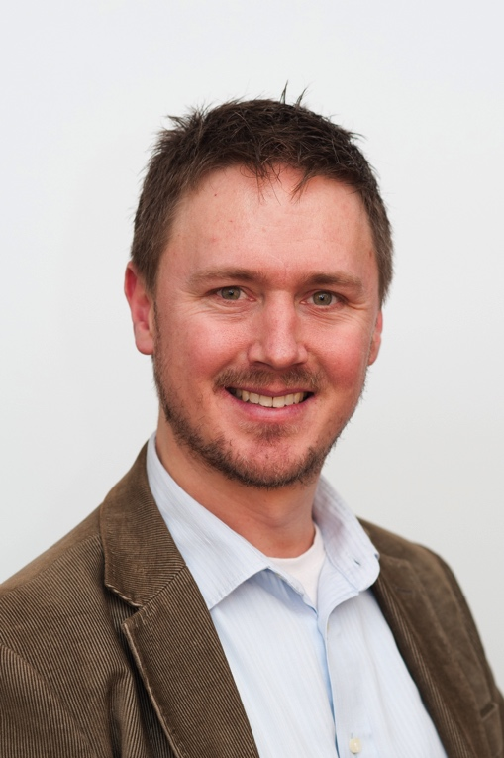
About me…
Brook Schofield GÉANT Association mailto:schofield@terena.org skype://brookschofield tel:+31651553991 http://terena.org/~schofield
Australian living in The Netherlands. . Grew up on the island state of Tasmania. . 1st Chair of the AARNet eduroam Project Group. Secretary of the Global eduroam Governance Committee.

Slide 3
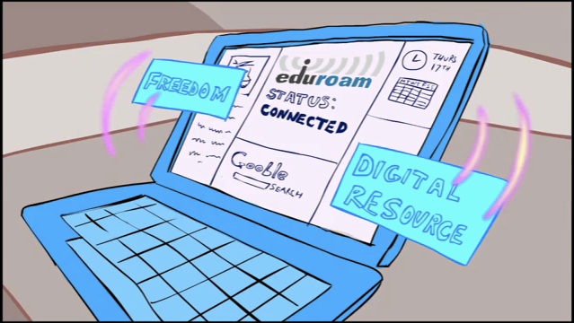
Promotional video
Visit http://youtu.be/TVCmcMZS3uA

Slide 4
What is eduroam?
eduroam is a global wireless roaming network, based on:
WPA2 & 802.1X (network access control)
RADIUS (infrastructure to transport credentials)
Trust fabric (RADIUS hierarchy and policy)
No web splash screen portal or shared passwords
Started in the TERENA Task Force “Mobility”
eduroam = education roaming
Notes:
eduroam (education roaming) is the secure, world-wide roaming access service developed for the international research and education community. eduroam can work equally well on wired and wireless connections (most commonly implemented on wireless – and is most popular for student dormitories for wired use).

Slide 5
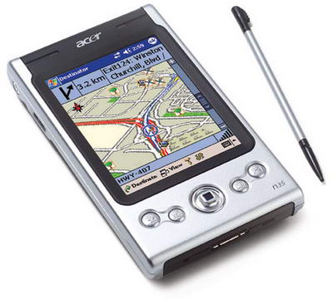
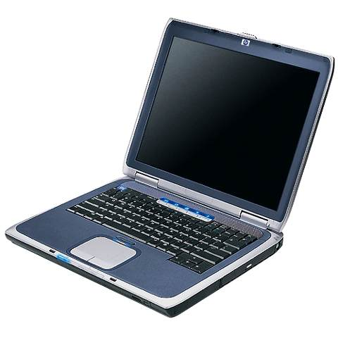
eduroam Infrastructure
WiFi
Access Point
RADIUS server
University 123
RADIUS server
University ABC
User DB
User DB
user@uniabc.aq
Roaming
Operator
Employee
VLAN
Visitor
VLAN
Central RADIUS
Proxy server
Student
VLAN
Trust based on national policy
Security based on 802.1X/RADIUS
VLAN assignment to separate users
signaling
data
Notes:
The area in the blue box is infrastructure that many universities will already have (if they have a sufficiently complex wifi environment). eduroam only requires the reconfiguration of their institutional RADIUS server and the creation of a “Central RADIUS Proxy Server” for their particular territory/economy/country.

Slide 6
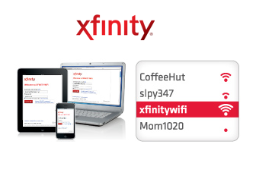
What else is like eduroam?
eduroam is similar to other wireless hotspots
…but eduroam is a service via an overlay
We don’t run our own hotspot infrastructure
Notes:
eduroam (education roaming) is the secure, world-wide roaming access service developed for the international research and education community. eduroam can work equally well on wired and wireless connections (most commonly implemented on wireless – and is most popular for student dormitories for wired use).

Slide 7
Why WLAN measurements….
Worst “franchise” in the world

Slide 8
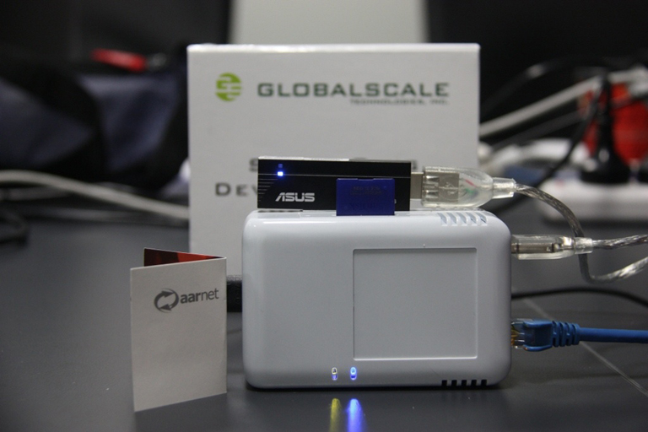
eduroam “pulse”
2009 - RIP
AARNet
SheevaPlug
≅€100
Didn’t Scale
Not a community

Slide 9
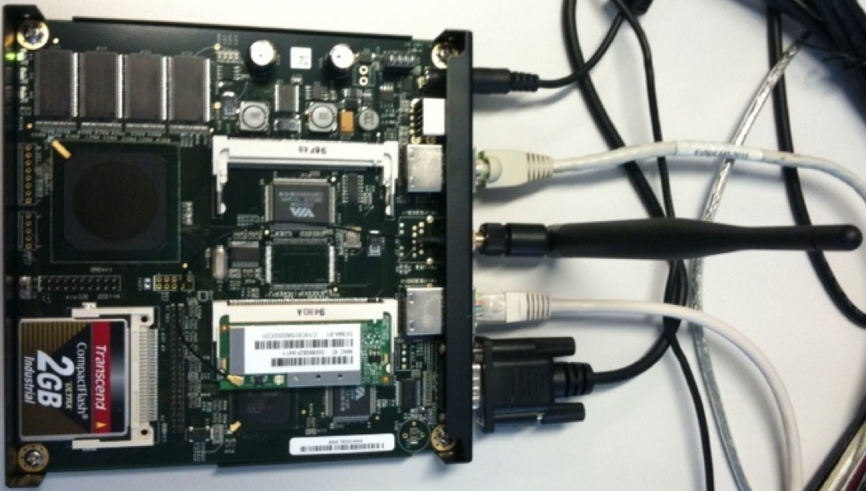
Active Monitoring eduroam Node (AMeN)
2009 – 2014 (still running)
Alix System
SURFnet
≅€150
Deployed at 14 sites
Deployment continues

Slide 10
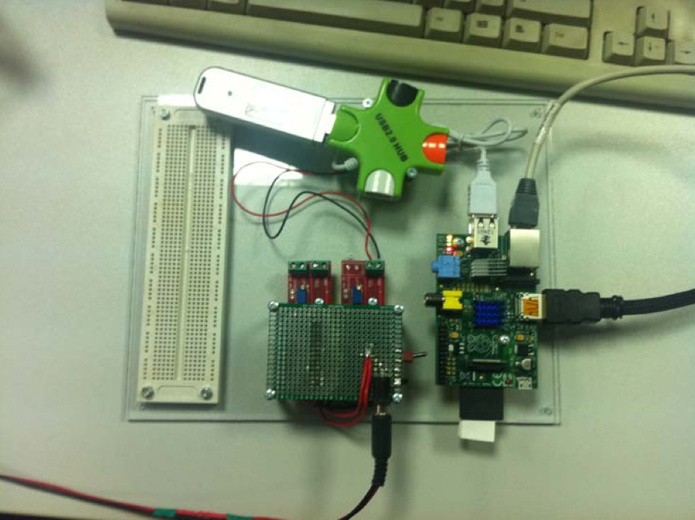
Srce Raspberry Pi (“Frankenprobe”)
2012 → Current
Raspberry Pi
Srce
≅€100
Not a solution
Scanning for SSIDs & Signal Quality

Slide 11
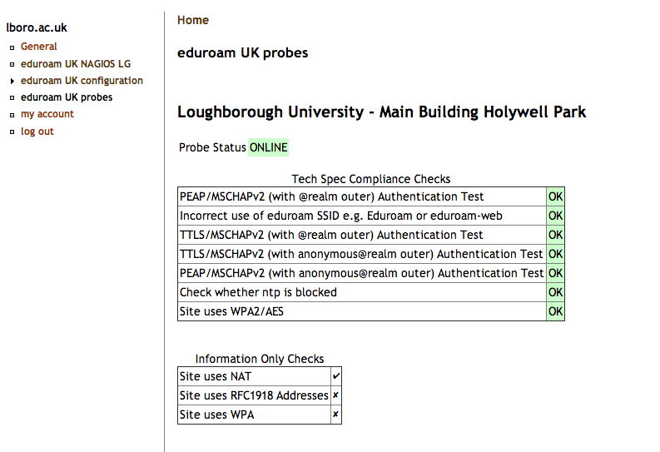
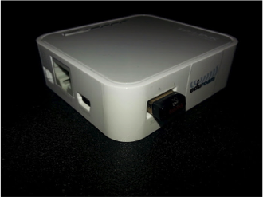
Janet/Loughborough Uni Probe
2012 – 2014 (still running)
wpa_supplicant & scripts
Growing from 20 to 200 probes now
TP-Link MR3020
≊ Atlas v3

Slide 12
Why WLAN measurements on Atlas?
Janet/Loughborough Uni as PoC
Proof that it can work…
…previous solutions show utility – but not scale.
eduroam ≅ Hotspot 2.0
Hotspot 2.0 + Next Generation Hotspot both 802.1X
WLAN hotspot providers might be interested in sponsoring
Atlas has the footprint + infrastructure
Can scale to >7k probes
Datasets can be public + available over time

Slide 13
What is in it for RIPE Atlas?
Bigger footprint in the R&E space
Currently many countries, ASNs and networks connected to GÉANT without an Atlas Probe
GÉANT and associated networks reach xx countries
Sponsorship from the eduroam community
Desire to define eduroam quality will encourage Atlas deployment
We willing to financially support Atlas

Slide 14
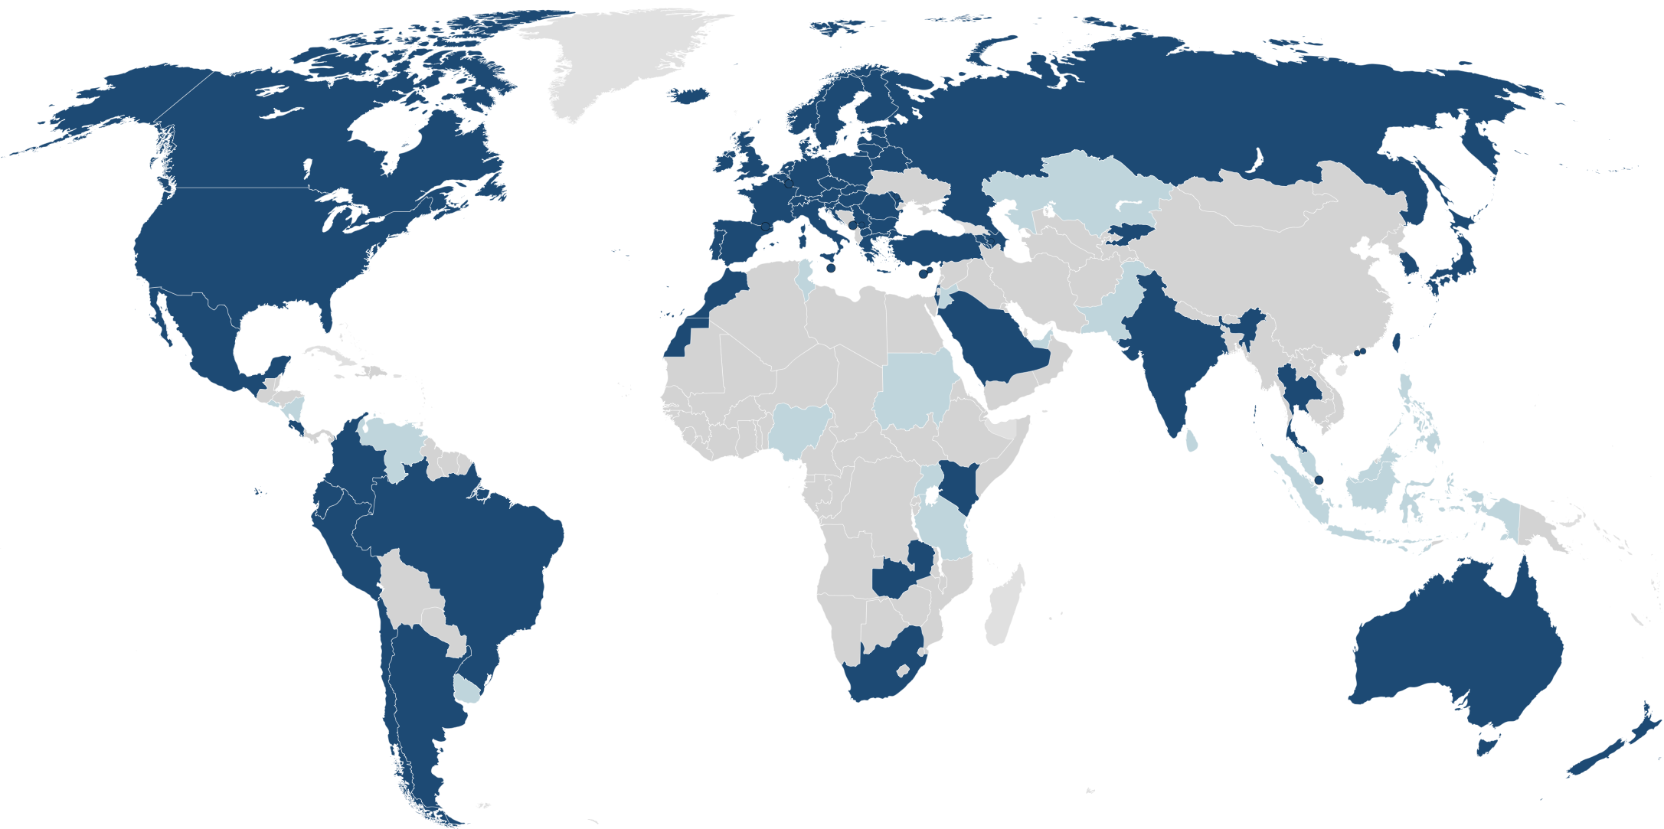
Where is eduroam?
eduroam
Pilot
:-(

Slide 15
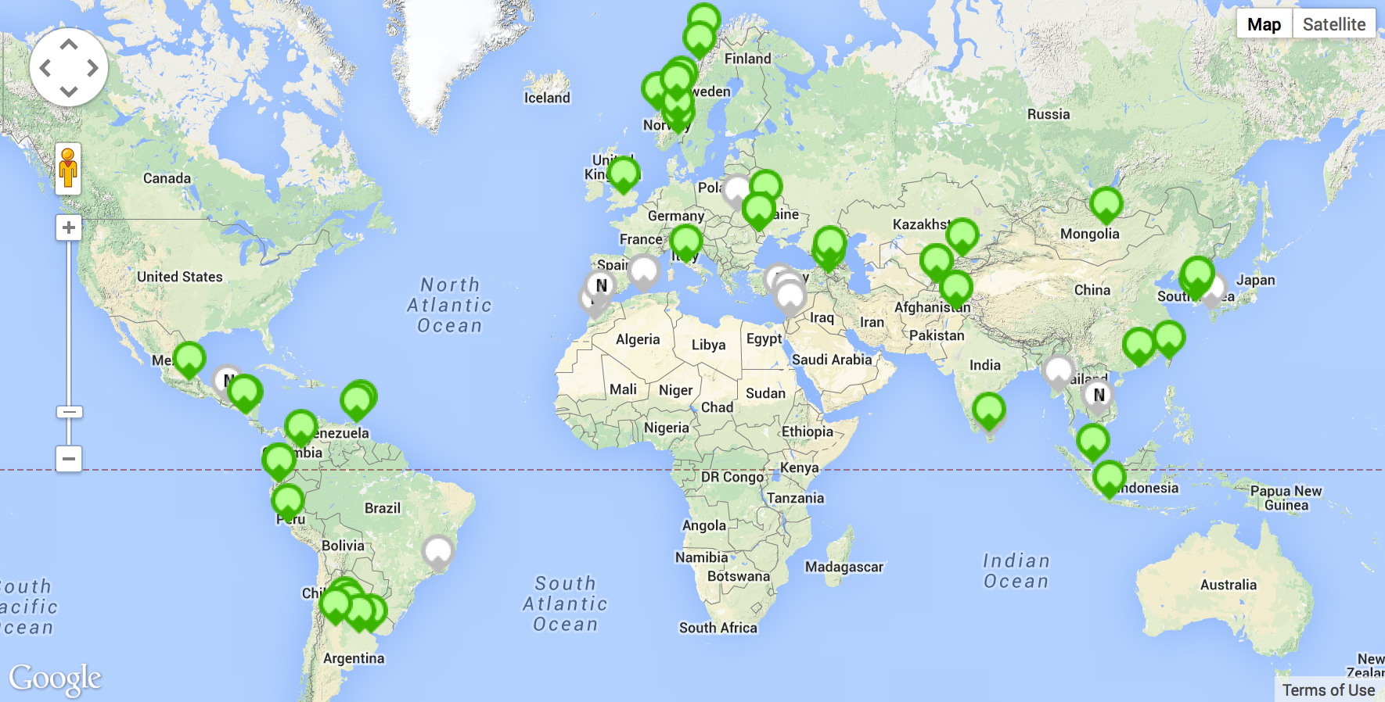
Where is eduroam?

Slide 16
What if RIPE say “No” to WLAN?
Anti-Pattern Deployment
AMeN, Loughborough & “Frankenprobe” will continue to be investigated and deployed
SURFnet willing to get out of the AMeN business
These tools don’t benefit RIPE or Atlas
Parallel network for measurements
Expenditure of “public” money on duplication
Atlas is more than probes…
Huge backend infrastructure & improvements

Slide 17
What next?
PoC code → Running on Atlas Dev/Test
What’s the current status?
An API for WLAN measurements
Scan
Associate
Authenticate (open or 802.1X)
Measurement (dns, ping, traceroute, cert - optional)
Report
Orchestration + Visualisation of WLAN Tests
Still a responsibility of eduroam Operations Team
Community can built on this infrastructure

Slide 18
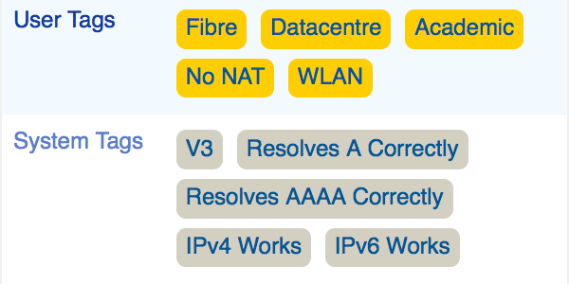
What next?
How to roll out WLAN capability?
User Tag?
Opt-in vs Opt-out
Other options…
Timeline
How important in relation to the roadmap?
Currently “In Progress”

Slide 19
Let’s Discuss…

Slide 20
Brook Schofield schofield@terena.org

